Slide 1
CPU Scheduling Lesson 4 Read-time Scheduling
David Liu
Fall 2021, Spring 2022

Slide 2
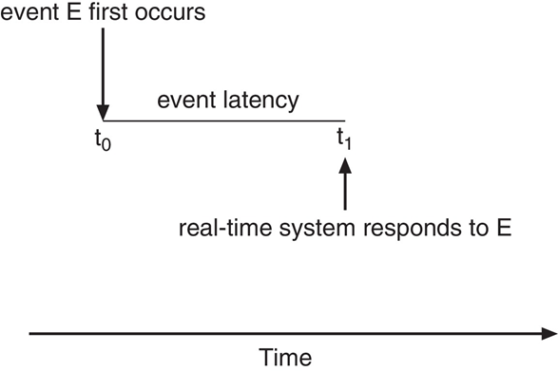
Real-Time Scheduling
Minimize event latency

Slide 3
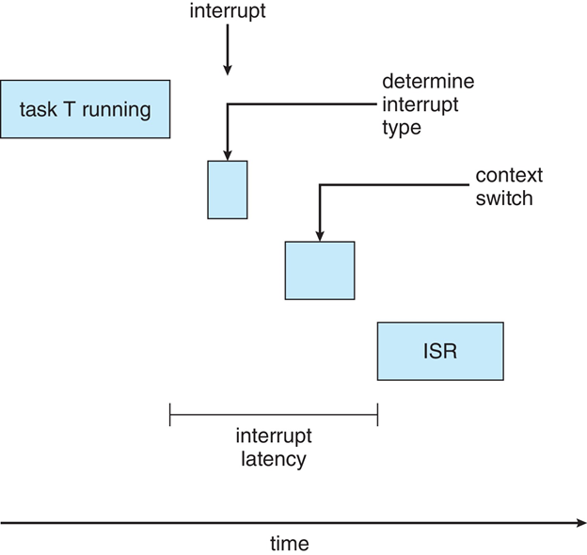
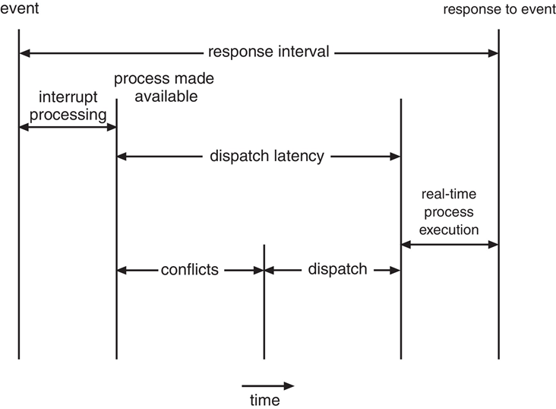
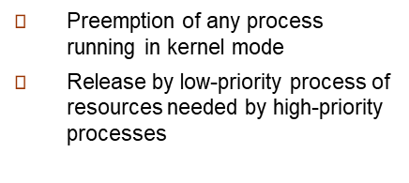
Interrupt vs Dispatch Latencies
Interrupt Latency
Dispatch Latency

Slide 4
Soft vs Hard Real time
Soft real-time
Support preemptive
Priority-based scheduling
Hard real-time
Support preemptive
Priority-based scheduling will not guarantee the hard deadline

Slide 5
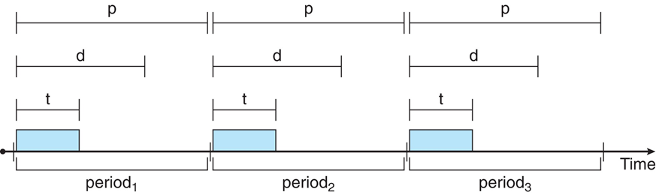
Process Model and Hard Real-Time
Processes have new characteristics: periodic ones require CPU at constant intervals
Has processing time t, deadline d, period p
0 ≤ t ≤ d ≤ p
Rate of periodic task is 1/p
Note: processing time t does not have to start at the beginning of each period.

Slide 6
Hard Real-time Scheduling
Rate monotonic scheduling
Earliest Deadline First Scheduling (EDF)
Proportional Share Scheduling

Slide 7
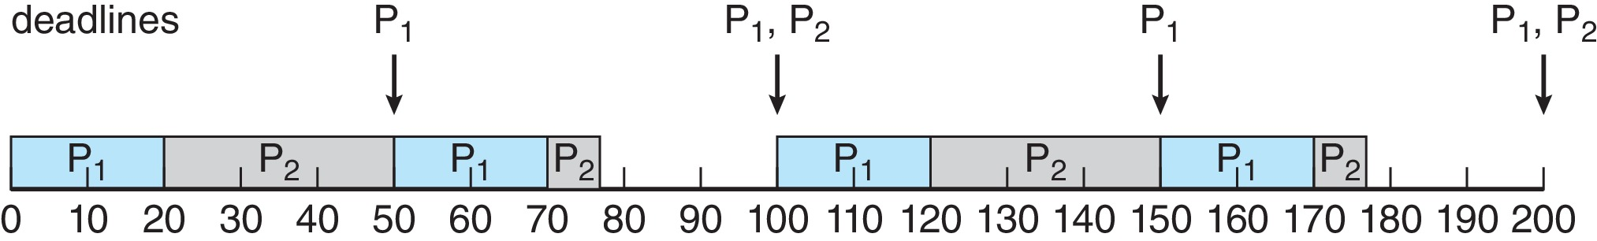
Rate Monotonic Scheduling
p₁ = d₁ = 50, t₁ = 20 25,
p₂ = d₂ = 100 80, t₂ = 35
Shorter period -> higher priority
p₁ = d₁ = 50, t₁ = 20,
p₂ = d₂ = 100, t₂ = 35
CPU utilization: 20/50 + 35/100 = 0.75 < 1.0
p₁ has higher priority

Slide 8
Rate Monotonic Scheduling
p₁ = d₁ = 50, t₁ = 20 25,
p₂ = d₂ = 100 80, t₂ = 35
CPU utilization: 25/50 + 35/80 = 0.94 < 1.0
Can RM schedules this meeting deadlines?

Slide 9
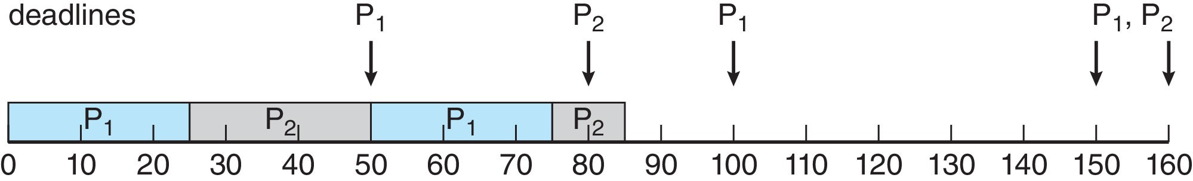
Rate Monotonic Scheduling
p₁ = d₁ = 50, t₁ = 20 25,
p₂ = d₂ = 100 80, t₂ = 35
CPU utilization: 25/50 + 35/100 = 0.94 < 1.0
Can RM schedules this meeting deadlines?

Slide 10
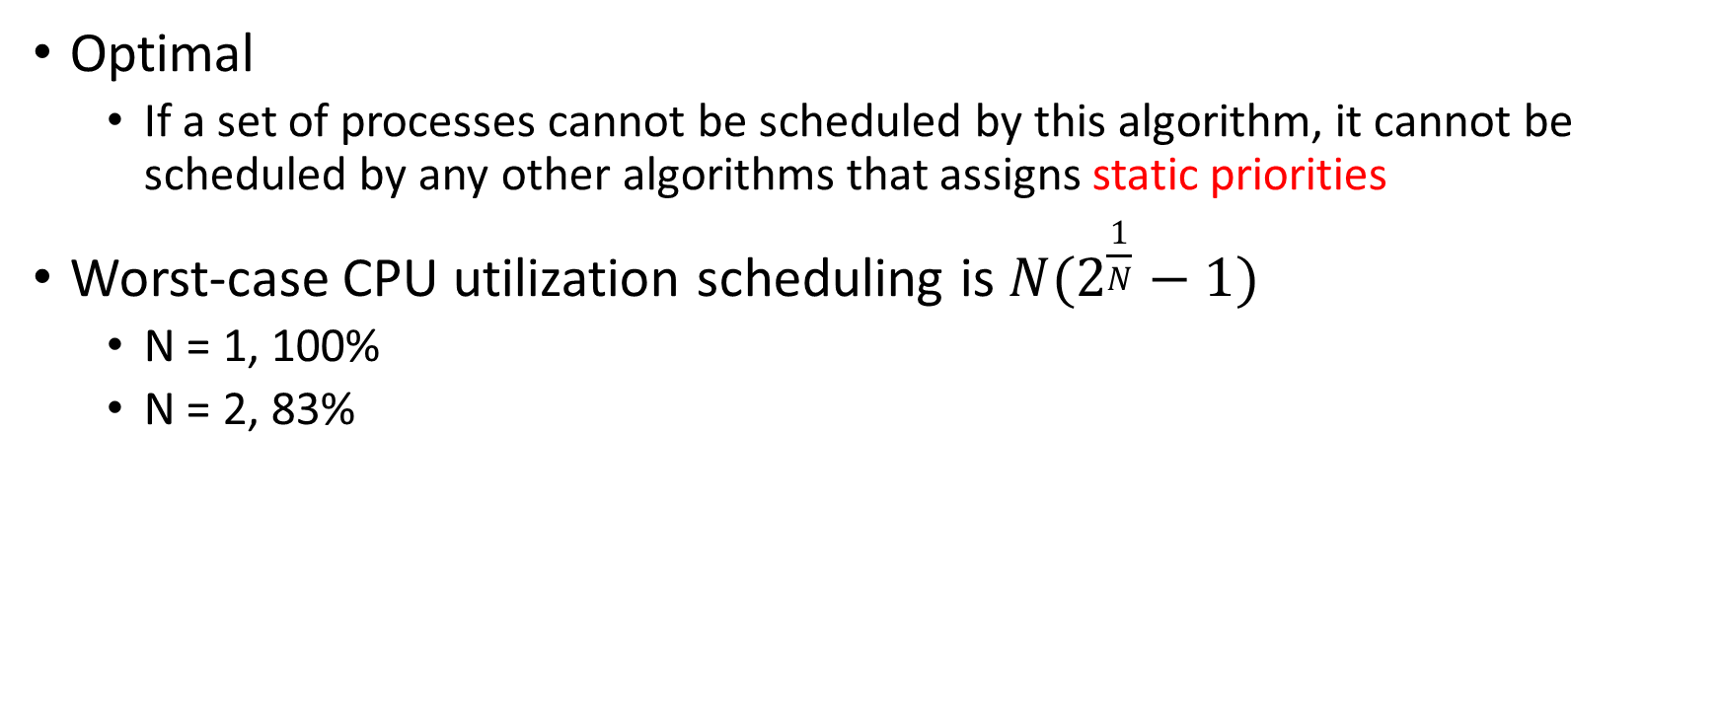
Rate Monotonic Scheduling Properties
Optimal
If a set of processes cannot be scheduled by this algorithm, it cannot be scheduled by any other algorithms that assigns static priorities
Worst-case CPU utilization scheduling is$N(2^{\frac{1}{N}}−1)$
N = 1, 100%
N = 2, 83%

Slide 11
Earliest Deadline First Scheduling (EDF)
Priorities are assigned according to deadlines
the earlier the deadline, the higher the priority;
p₁ = d₁ = 50, t₁ = 20,
p₂ = d₂ = 100, t₂ = 35
Please how two process are scheduled?

Slide 12
Earliest Deadline First Scheduling (EDF)
Priorities are assigned according to deadlines
the earlier the deadline, the higher the priority;
p₁ = d₁ = 50, t₁ = 20 25,
p₂ = d₂ = 100 80, t₂ = 35
Can EDF schedules and meet both processes’ deadlines??

Slide 13
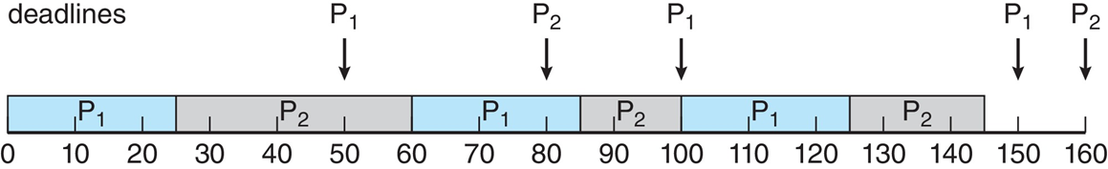
Earliest Deadline First Scheduling (EDF)
Priorities are assigned according to deadlines
the earlier the deadline, the higher the priority;
p₁ = d₁ = 50, t₁ = 20 25,
p₂ = d₂ = 100 80, t₂ = 35
Yes. We can.

Slide 14
Proportional Share Scheduling
T shares are allocated among all processes in the system
An application receives N shares where N < T
This ensures each application will receive N / T of the total processor time
T = 100
Applications: A = 50, B = 15, C = 20
Essentially admission-controlled policy only admit a new process if sufficient shares are available.

